Slide 1
Regularizing deep neural network

Slide 2
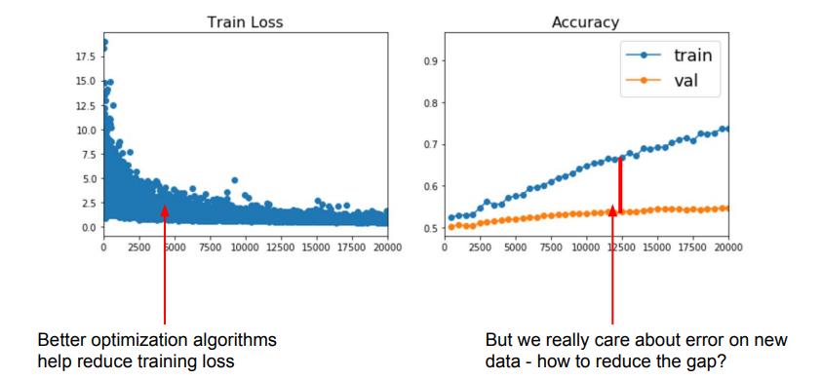
Regularization
A central problem in machine learning is how to make an algorithm that will perform well not just on the training data, but also on new inputs.
Last lecture was focused on “optimization” that is, to design algorithm to work well on the training data (i.e., reduce training error)
In this section we focus on “generalization “, that is, how to get the algorithm to work well on new data not used for optimization.
Strategies to reduce the test/prediction error, possibly at the expense of increased training error are collectively referred to as regularization
we will discuss some most common techniques:
Weight Decay (L2 regularization)
Model Ensemble
Dropout
Early Stopping
Image source:http://cs231n.stanford.edu/slides/2018/cs231n_2018_lecture07.pdf

Slide 3
Weight decay (L2 regularization)
Recall from lecture 1. preliminaries that regularization strives to find the right model capacity for the task they are trying to solve and the amount of data they are provided with
The generalization error has a U-shape relation with model complexity ( refer to lecture 1, slide 95) As we increase the model capacity, the generalization error is decreased up to a certain point where the capacity is optimal for the task and data after which the generalization error starts to increase and model starts to overfit.
Recall from lecture 1, that weight decay is a regularization technique that attempts to limit the capacity of a parametric model by penalizing parameters with large magnitude.
To do this, weight decay adds the squared L2 norm of the parameters to the loss function.
This way, the optimization algorithm will not only try to minimize the training error but, at the same time, minimizes the size/magnitude of the parameters.

Slide 4
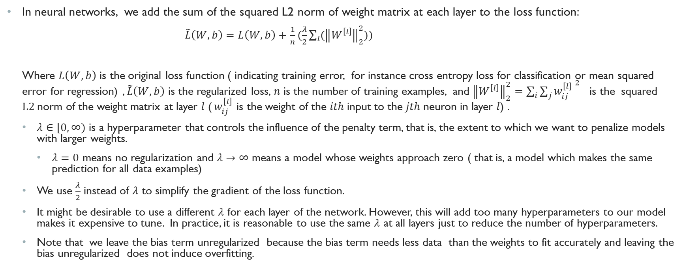
Weight decay in neural networks
In neural networks, we add the sum of the squared L2 norm of weight matrix at each layer to the loss function:
$\tilde{L}\left(W,b\right)=L\left(W,b\right)+\frac{1}{n}(\frac{λ}{2}{\sum_{l}{(\left\|W^{\left[l\right]}\right\|}}_{2}^{2}))$
Where $L\left(W,b\right)$ is the original loss function ( indicating training error, for instance cross entropy loss for classification or mean squared error for regression) , $\tilde{L}\left(W,b\right)$ is the regularized loss, $n$ is the number of training examples, and ${\left\|W^{\left[l\right]}\right\|}_{2}^{2}=\sum_{i}{\sum_{j}{{w_{ij}^{\left[l\right]}}^{ 2}}}$ is the squared $L2$norm of the weight matrix at layer $l$ ($w_{ij}^{\left[l\right]}$ is the weight of the $ith$input to the $jth$neuron in layer $l$) .
$λ∈[0,∞)$ is a hyperparameter that controls the influence of the penalty term, that is, the extent to which we want to penalize models with larger weights.
$λ=0$ means no regularization and $λ→∞$ means a model whose weights approach zero ( that is, a model which makes the same prediction for all data examples)
We use $\frac{λ}{2}$ instead of $λ$ to simplify the gradient of the loss function.
It might be desirable to use a different $λ$ for each layer of the network. However, this will add too many hyperparameters to our model makes it expensive to tune. In practice, it is reasonable to use the same $λ$ at all layers just to reduce the number of hyperparameters.
Note that we leave the bias term unregularized because the bias term needs less data than the weights to fit accurately and leaving the bias unregularized does not induce overfitting.

Slide 5
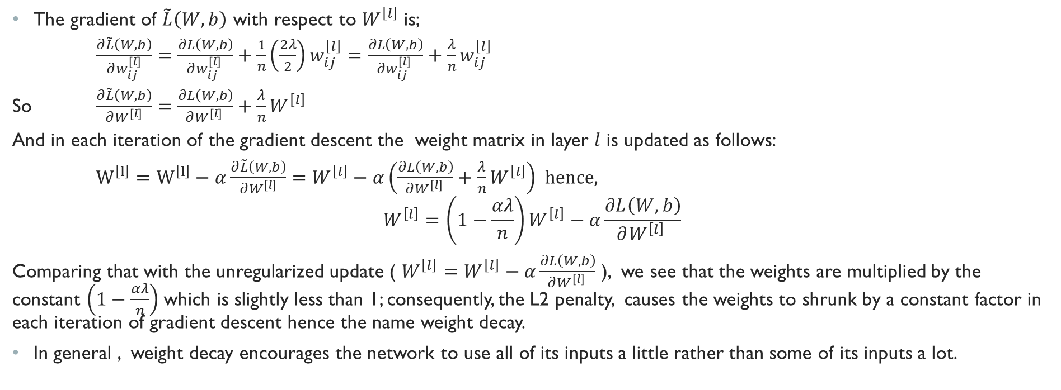
Weight Decay in neural networks (cont.)
The gradient of $\tilde{L}\left(W,b\right)$ with respect to $W^{\left[l\right]}$ is;
$\frac{∂\tilde{L}\left(W,b\right)}{∂w_{ij}^{\left[l\right]}}=\frac{∂L\left(W,b\right)}{∂w_{ij}^{\left[l\right]} }+\frac{1}{n}\left(\frac{2λ}{2}\right)w_{ij}^{\left[l\right]}=\frac{∂L\left(W,b\right)}{∂w_{ij}^{\left[l\right]} }+\frac{λ}{n}w_{ij}^{\left[l\right]}$
So $\frac{∂\tilde{L}\left(W,b\right)}{∂W^{\left[l\right]}}=\frac{∂L\left(W,b\right)}{∂W^{\left[l\right]} }+\frac{λ}{n}W^{\left[l\right]}$
And in each iteration of the gradient descent the weight matrix in layer $l$ is updated as follows:
$W^{\left[l\right]}=W^{\left[l\right]}−α\frac{∂\tilde{L}\left(W,b\right)}{∂W^{\left[l\right]}}=W^{\left[l\right]}−α\left(\frac{∂L\left(W,b\right)}{∂W^{\left[l\right]} }+\frac{λ}{n}W^{\left[l\right]}\right)$ hence,
$$W^{\left[l\right]}=\left(1−\frac{αλ}{n}\right)W^{\left[l\right]}−α\frac{∂L\left(W,b\right)}{∂W^{\left[l\right]} }$$
Comparing that with the unregularized update ( $W^{\left[l\right]}=W^{\left[l\right]}−α\frac{∂L\left(W,b\right)}{∂W^{\left[l\right]} }$ ), we see that the weights are multiplied by the constant $\left(1−\frac{αλ}{n}\right)$ which is slightly less than 1; consequently, the L2 penalty, causes the weights to shrunk by a constant factor in each iteration of gradient descent hence the name weight decay.
In general , weight decay encourages the network to use all of its inputs a little rather than some of its inputs a lot.

Slide 6
Bagging and Other ensemble methods
Bagging (short for bootstrap aggregating) is a technique for reducing generalization error by combining several models for the same machine learning task.
The idea is to train several diﬀerent models separately, then have all the models vote on the output for test examples
This is an example of a general strategy in machine learning called model averaging. Techniques employing this strategy are known as ensemble methods
The reason that model averaging reduces the test error is that diﬀerent models will usually not make all the same errors on the test set.
Diﬀerent ensemble methods construct the ensemble of models in diﬀerent ways.
For example, each member of the ensemble could be formed by training a completely diﬀerent kind of model using a diﬀerent algorithm or objective function
Bagging is the most simple type of model ensemble that allows the same kind of model, training algorithm and objective function to be reused several times
In bagging we construct k different datasets from the training examples. Each dataset has the same size as the original training dataset and is obtained by sampling with replacement from the original dataset. This means that each dataset has some examples missing from the original dataset and contains several duplicate examples. A separate model is then trained on each dataset and predictions are averaged at test time resulting in a better test error

Slide 7
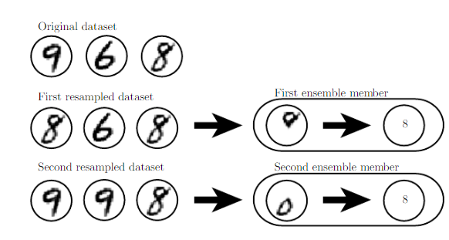
Bagging Example
Consider a toy example where we want to build a classifier which can detect the digit 8. We have a tiny dataset of three examples 9,6, and 8.
Suppose we make two diﬀerent resampled datasets. The bagging training procedure is to construct each of these datasets by sampling with replacement.
First dataset omits the 9 and repeats 8. Suppose that a classifier trained on this dataset learns that the a loop on the top corresponds to 8
Second dataset omits 6 and repeats 9. Suppose that a classifier trained on this dataset learns that a loop at the bottom corresponds to 8.
Each classifier individually is brittle but if we average their outputs, then the resulting classifier is robust, achieving maximal conﬁdence only when both loops of the 8 are present.

Slide 8
Model Ensemble in neural networks
Differences in random initialization of parameters, in random selection of mini-batches, and in hyperparameters causes different neural network models to arrive at different solutions even if they are trained on the same dataset.
Consequently, neural network models can benefit greatly from model ensemble even if all models are trained on the same dataset.
Model ensemble /averaging is an extremely powerful and reliable method for reducing generalization error in machine learning
In fact, many machine learning contests are usually won by methods using model averaging over dozens of models.
Any machine learning model can benefit substantially from model averaging at the price of increased computation and memory.
Model averaging such as bagging requires training multiple models (instead of a single model) and evaluating multiple models on each test example.
This is impractical when each model is a large deep neural networks because training and evaluating such networks is costly in terms of runtime and memory
It is common to use ensemble of five or ten neural networks but more than this rapidly becomes impractical.
A regularization method called dropout allow us to get an approximation of training and evaluating a bagged ensemble of many neural networks without having to train multiple models.

Slide 9
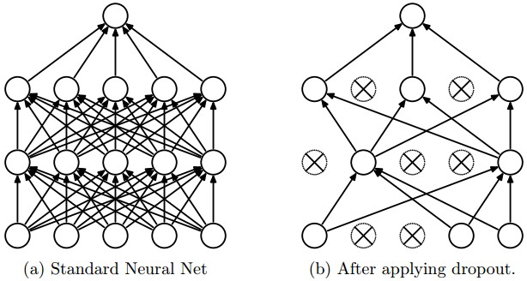
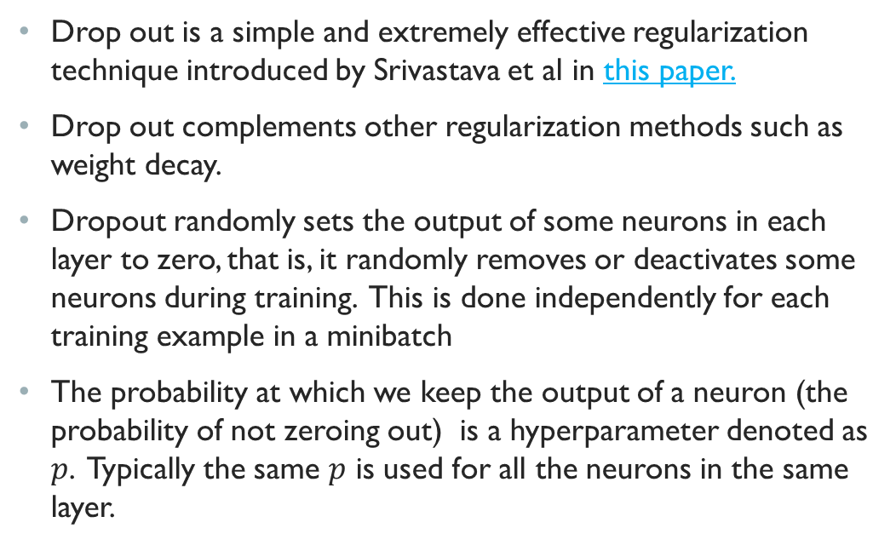
Drop out Regularization
Drop out is a simple and extremely effective regularization technique introduced by Srivastava et al in this paper.
Drop out complements other regularization methods such as weight decay.
Dropout randomly sets the output of some neurons in each layer to zero, that is, it randomly removes or deactivates some neurons during training. This is done independently for each training example in a minibatch
The probability at which we keep the output of a neuron (the probability of not zeroing out) is a hyperparameter denoted as $p$. Typically the same $p$ is used for all the neurons in the same layer.

Slide 10
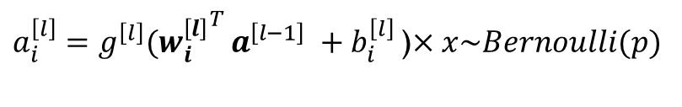
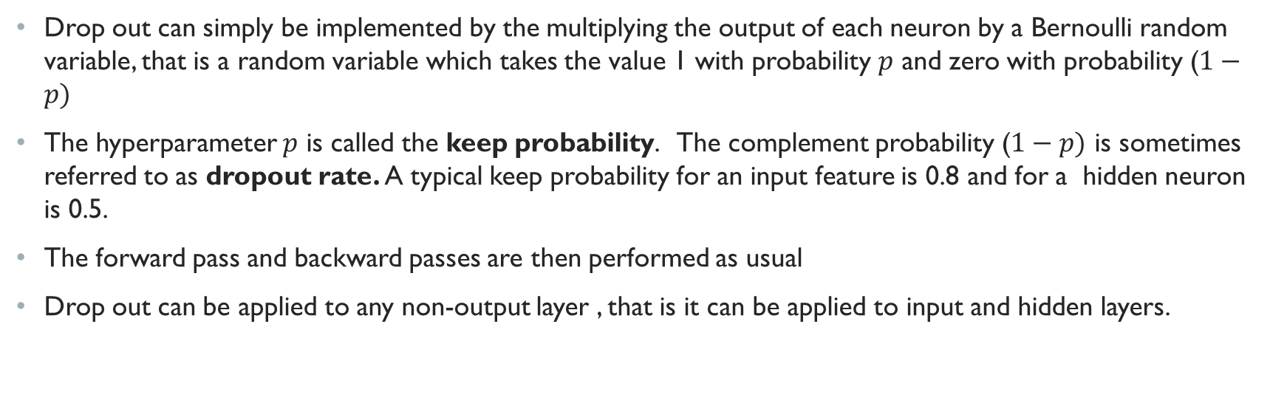


Dropout at training
Drop out can simply be implemented by the multiplying the output of each neuron by a Bernoulli random variable, that is a random variable which takes the value 1 with probability $p$ and zero with probability ($1−p)$
The hyperparameter $p$ is called the keep probability. The complement probability ($1−p)$ is sometimes referred to as dropout rate. A typical keep probability for an input feature is 0.8 and for a hidden neuron is 0.5.
The forward pass and backward passes are then performed as usual
Drop out can be applied to any non-output layer , that is it can be applied to input and hidden layers.
$$a^{\left[l−1\right]}$$
${a_{i}^{\left[l\right]}=g}^{\left[l\right]}({w_{i}^{\left[l\right]}}^{T }a^{\left[l−1\right]} +b_{i}^{\left[l\right]}$)$×x\sim Bernoulli(p)$
$$<w_{i}^{\left[l\right]},b_{i}^{\left[l\right]}>$$

Slide 11
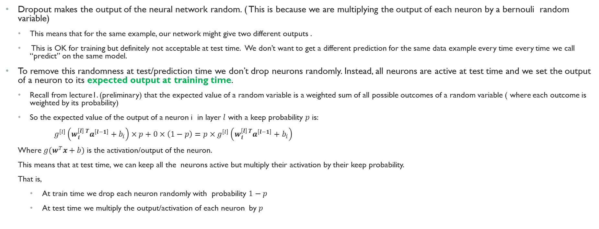
Dropout at test time
Dropout makes the output of the neural network random. ( This is because we are multiplying the output of each neuron by a bernouli random variable)
This means that for the same example, our network might give two different outputs .
This is OK for training but definitely not acceptable at test time. We don’t want to get a different prediction for the same data example every time every time we call “predict” on the same model.
To remove this randomness at test/prediction time we don’t drop neurons randomly. Instead, all neurons are active at test time and we set the output of a neuron to its expected output at training time.
Recall from lecture1. (preliminary) that the expected value of a random variable is a weighted sum of all possible outcomes of a random variable ( where each outcome is weighted by its probability)
So the expected value of the output of a neuron i in layer $l$ with a keep probability $p$ is:
$g^{\left[l\right]}\left(w_{i}^{\left[l\right] T}a^{\left[l−1\right]}+b_{i}\right)×p+0×\left(1−p\right)=p×g^{\left[l\right]}\left(w_{i}^{\left[l\right] T}a^{\left[l−1\right]}+b_{i}\right)$
Where $g(w^{T}x+b)$ is the activation/output of the neuron.
This means that at test time, we can keep all the neurons active but multiply their activation by their keep probability.
That is,
At train time we drop each neuron randomly with probability $1−p$
At test time we multiply the output/activation of each neuron by $p$

Slide 12
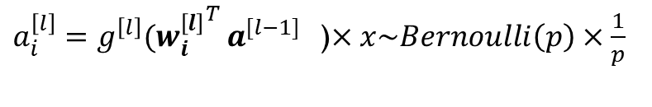
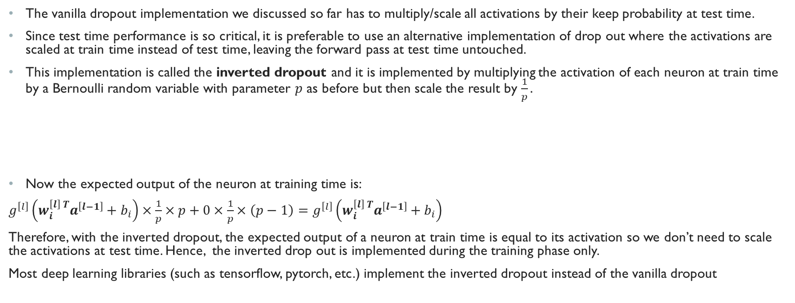


Inverted dropout
The vanilla dropout implementation we discussed so far has to multiply/scale all activations by their keep probability at test time.
Since test time performance is so critical, it is preferable to use an alternative implementation of drop out where the activations are scaled at train time instead of test time, leaving the forward pass at test time untouched.
This implementation is called the inverted dropout and it is implemented by multiplying the activation of each neuron at train time by a Bernoulli random variable with parameter $p$ as before but then scale the result by $\frac{1}{p}.$
Now the expected output of the neuron at training time is:
$g^{\left[l\right]}\left(w_{i}^{\left[l\right] T}a^{\left[l−1\right]}+b_{i}\right)×\frac{1}{p}×p+0×\frac{1}{p}×\left(p−1\right)=g^{\left[l\right]}\left(w_{i}^{\left[l\right] T}a^{\left[l−1\right]}+b_{i}\right)$
Therefore, with the inverted dropout, the expected output of a neuron at train time is equal to its activation so we don’t need to scale the activations at test time. Hence, the inverted drop out is implemented during the training phase only.
Most deep learning libraries (such as tensorflow, pytorch, etc.) implement the inverted dropout instead of the vanilla dropout
$$a^{\left[l−1\right]}$$
${a_{i}^{\left[l\right]}=g}^{\left[l\right]}({w_{i}^{\left[l\right]}}^{T }a^{[l−1]}$)$×x\sim Bernoulli\left(p\right)×\frac{1}{p}$
$$<w_{i}^{\left[l\right]},b_{i}^{\left[l\right]}>$$

Slide 13
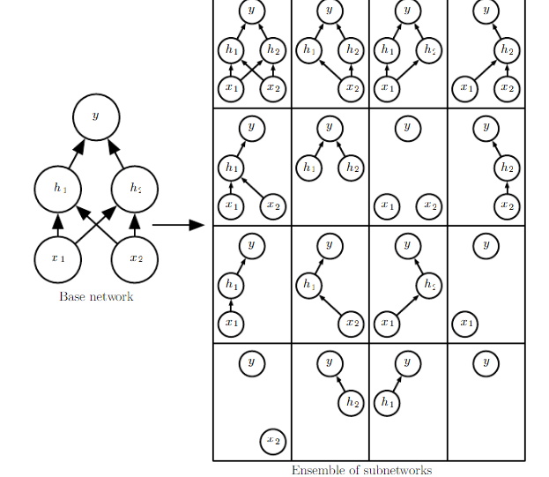
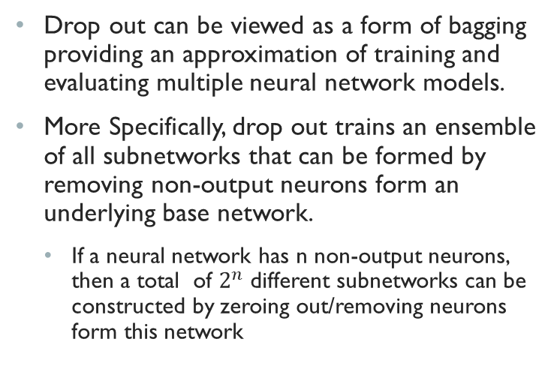
Why dropout reduce generalization error?
Drop out can be viewed as a form of bagging providing an approximation of training and evaluating multiple neural network models.
More Specifically, drop out trains an ensemble of all subnetworks that can be formed by removing non-output neurons form an underlying base network.
If a neural network has n non-output neurons, then a total of $2^{n}$ different subnetworks can be constructed by zeroing out/removing neurons form this network

Slide 14
Why dropout reduce generalization error (Cont.)?
Unlike standard bagging, however, the models constructed this way are not independent because they share the same parameters with each model inheriting a diﬀerent subset of parameters from the parent neural network
This parameter sharing makes it possible to represent an exponential number of models with a tractable amount of memory
In dropout we don’t explicitly train all possible subnetworks.
If the model is large it wouldn’t be possible to train all of its subnetworks within the lifetime of the universe!!!
Instead, in each step/minibatch we only train a tiny fraction of all possible subnetwork but since all subnetworks share parameters, the remaining subnetworks also arrive at a good setting of the parameters.
In bagging, we take the average predictions from all bagged models to reduce variance and increase generalization. In dropout we estimate the average predictions from all subnetwork by computing the expected activation of each neuron.

Slide 15
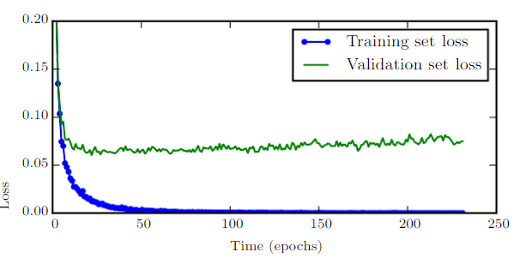
Early stopping
When training large models with suﬃcient representational capacity to overﬁt the task, we often observe that training error decreases steadily over time, but the validation set error begins to rise again.
Early Stopping is the most simple form of regularization in deep learning
Early stopping is based on the idea that we can obtain a model with better validation set error (and thus, hopefully better test set error) by returning to the parameter setting at the point in time with the lowest validation set error
This is implemented by storing a copy of the model parameter every time there is an improvement in the validation error
Once the training algorithm terminates we return these parameters rather than the latest parameters
The training terminates when no parameters have improved over the best recorded validation error for some pre-speciﬁed number of iteration
Early stopping can be used in conjunction with other regularization methods such as dropout and weight decay

